Slide 1

Term Project Motion-Print Control Task Movements TasksIncludeMovements_4000timmins8010 – Dataset Analysis

Slide 2
Content
Problem Overview
Dataset Overview
Process Summarization Flowchart
Training and Test Set Visualization
Conclusion

Slide 3
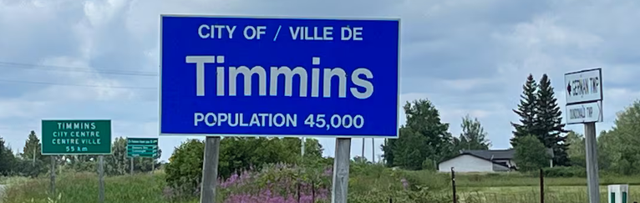
Problem Overview
The Mobile Crowd Sensing (MCS) benchmarking dataset is used for security and task validation in smart cities. It is designed to train machine learning models to detect fake, malicious, or spammed tasks submitted by adversaries to an MCS platform.
In Mobile Crowd Sensing, platforms recruit everyday citizens (crowd sensors) to collect data using their smartphones (e.g., traffic conditions, air quality). Malicious users often submit fake tasks to waste platform resources, exhaust worker batteries, or manipulate data. This dataset mimics that scenario so researchers can build classification models to filter out fraudulent submissions before they reach real workers.

Slide 4
End-to-End Conceptual Dataflow: MCS Task Legitimacy Challenge
The Mobile Crowd Sensing (MCS) platform dataflow diagram below outlines the detection of illegitimate sensing tasks. These fake tasks introduce inefficiencies in the platform and participant hardware compared to legitimate processes.
Malicious Actor
80% Peak Hours
Rejected Path
(Illegitimate)
High Battery Request
(80%: 7% - 10%)
0
Fake Coverage
Mapping
Day 0-4
Data Trained
Illegitimate
(Fake) Tasks
A
MCS Participant
Platform Inefficiency
Battery Drain (Edge Participants)
Spatial-Temporal Inaccuracy
MCS Platform Prediction Model
Distributed Hours
Day 5-6 Predictions
Features Evaluated –
Spatial, Temporal, Battery
B
Recorded Data
Variable Duration
1
Real Data Collection
Legitimate
Tasks
Accepted Path
(Legitimate)
Authenticated
Users
The Attack Mechanism: Adversaries deploy location-based clogging strategies by submitting highly demanding task constraints during peak operational windows to intentionally exhaust edge network capacity.
The Defensive Mandate: Because the platform remains blind to target verification parameters at submission time, the classifier must rely solely on behavioral discrepancies hidden across the spatial, temporal, and consumption signatures.
MCS Participant
Resource Preservation
Reliable Coverage
Battery Optimization

Slide 5
Dataset Overview
INPUT FEATURES
Special Attributes:
Latitude, Longitude
GridNumber
Temporal Attributes:
Hour, Minute
OnPeakHours
Task Demand Vectors:
Duration, RemainingTime
Resources (Battery %)
Coverage
THE MODEL
Algorithms:
Machine Learning Pipeline
Decision Trees, SVM, KNN
OUTPUTS
Prediction Outcome
Legitimacy:
0 = Fake
1 = Legitimate

Slide 6
End-to-End Operational Flowchart: MCS Task Legitimacy Pipeline
YES
(Day 0-4)
Drop ID, Minute, RemTime
Filter by Day?
Create
Training Set
Cleaned Training Set
Start: Raw Simulation Dataset
(14,306 Tasks)
NO
YES
(Day 5-6)
Drop Day Column (Data Leakage Prevention)
Create
Test Set
Error
Full Feature Set:
ID, Lat, Lon, Day, Hour Min, Duration, RemTime, Resources, Coverage, Legitimacy, OnPeak, Geid Num
Drop Day Column (Data Leakage Prevention)
Test Set
PHASE 1: DATA CLEANING & SPLITTING

Slide 7
End-to-End Operational Flowchart: MCS Task Legitimacy Pipeline
Generate t-SNE Plots
(Time vs. Test Coverage)
Apply Filter Method:
Mutual Information
Classification
KNN
NO
Train Baseline Models
Evaluate Test F-1 Scores
Rank Features by MI Score
Optimize Size?
SVM
(RBF Kernel)
Decision Tree
YES
Evaluate Test F-1 Scores
Bar Chart and Confusion Matrix
Optimal Feature Subset
(K features with Max F1 score)
PHASE 2: VISUALIZATION & Q1 BASELINE MODELS
PHASE 3: Q2 FEATURE SELECTION

Slide 8
End-to-End Operational Flowchart: MCS Task Legitimacy Pipeline
YES
Generate SOFM Labels
PKI Concatenation: Append SOFM to Q2 Subset
2x2
(4 nodes)
YES
3x3
(9 nodes)
Generate SOFM Labels
Phase 1:
Cleaned Training Set
Isolate Lat/Lon Features
Fit SOFM Grids
YES
YES
4x4
(16 nodes)
Generate SOFM Labels
YES
5x5
(25 nodes)
Generate SOFM Labels
Train
Advanced Models
Plot Results:
Grid Size vs.
F-1 Score
End: Quantitive Summary & Conclusion
Random Forest
XGBoost
PHASE 4: Q3 PRIOR KNOWLEDGE (PKI) WITH SOFM

Slide 9
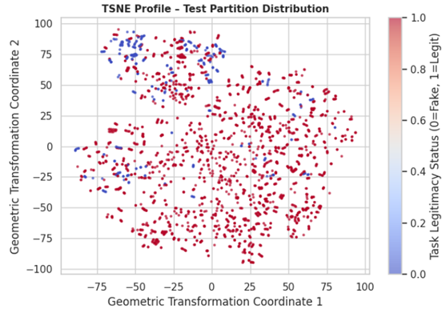
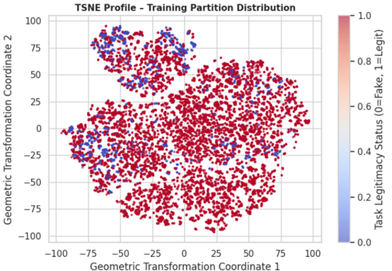
Dataset Validation: t-SNE Manifold Mapping & Distribution Drift
Legitimate tasks=1 (red), dominate the plot while the fake tasks (blue). This shows an evaluation with F1 Score is essential to overcome the bias that could result from the severe class imbalance of 12K legitimates tasks vs. the ~ 2K fake tasks
Due to strong underlying spatial and feature grouping in the data, distinct clusters are observed. This justifies using Self-Organizing Feature Maps (SOFM) to partition Latitude and Longitude attributes into well-defined grid regions, providing downstream classifiers with Prior Knowledge Input (PKI)
The training and test sets are shown to almost match identically, representing the split shows no data or distribution drift. This shows the models trained on Days 0-4 will generalize reasonably well to days 5-6
TRAINING AND TEST SET VISUALIZATION

Slide 10
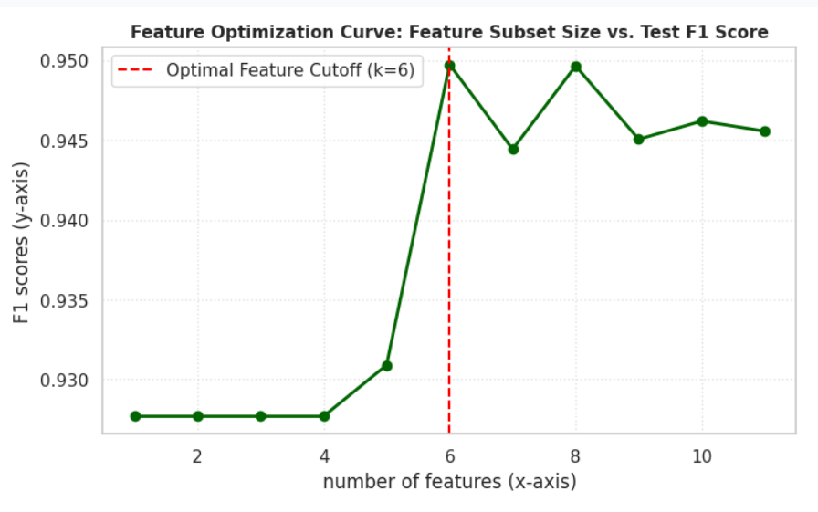
Strategic Selection of 6 Key Features Maximizes Predictive Accuracy
Quantitative Summary of Results
Feature Selection Improvement:
As shown in the plot, performance remains flat when using fewer than 5 features. However, once we hit 6 features—specifically including GridNumber, ID, Longitude, Latitude, Hour, and Resources—our F1 score reaches its peak at approximately 0.9497.
CONCLUSION

Slide 11
Baseline Classifier Performance & Comparison
Quantitative Summary of Results
Baseline Performance Benchmark:
We established our baseline performance by evaluating three distinct baseline algorithms—KNN, SVM, and Decision Tree—on the scaled feature set using our temporal split of Days 0–4 for training and Days 5–6 for testing.
As shown in the bar chart below left, Decision Tree emerged as our top-performing baseline model, achieving a test F1 score of 0.9834, outperforming both SVM at 0.9456 and KNN at 0.9359.
Looking at the confusion matrix below right for our top Decision Tree model, out of over 2,500 test samples, the model correctly identified 2,162 legitimate tasks and 308 fake tasks, with only 73 total misclassifications. This 0.9834 F1 score serves as our baseline benchmark for the remaining analysis.
CONCLUSION

Slide 12
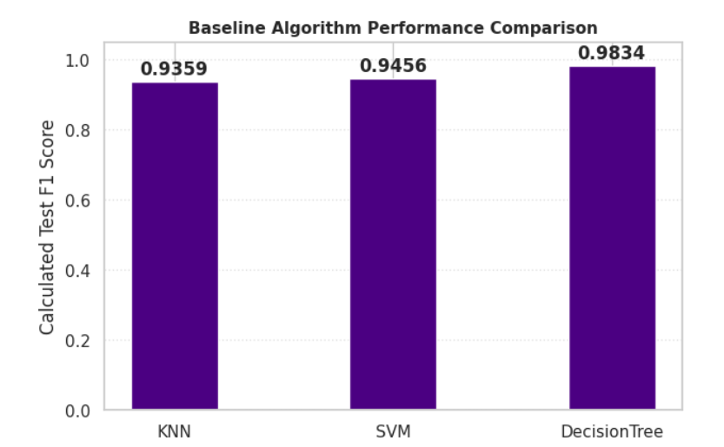
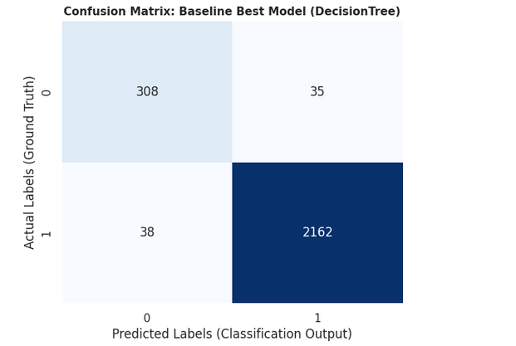
Baseline Classifier Performance & Comparison
F_1 score comparison across baseline classifiers on Days 5–6 test set.
Confusion matrix for top baseline classifier (Decision Tree, F_1 = 0.9834)
CONCLUSION

Slide 13
Results: Spatial Prior Knowledge Input (PKI) Optimization
Quantitative Summary of Results
Spatial PKI Performance (SOFM Injection):
We evaluated our Prior Knowledge Input (PKI) strategy by mapping spatial attributes into Self-Organizing Feature Map (SOFM) grid clusters ranging from 2×2 to 5×5 neurons. As shown in the results, incorporating spatial grid features enabled both Random Forest and XGBoost models to consistently outperform the Q1 raw baseline (F1 = 0.9834) and the Q2 feature-selection benchmark (F1 = 0.9497). Performance remained remarkably stable across all SOFM configurations, suggesting that the PKI approach was robust to grid size selection. XGBoost delivered the strongest results overall, achieving a peak test-set F1 score of approximately 0.998 on the 5×5 grid, although differences between grid sizes were minimal.
CONCLUSION

Slide 14
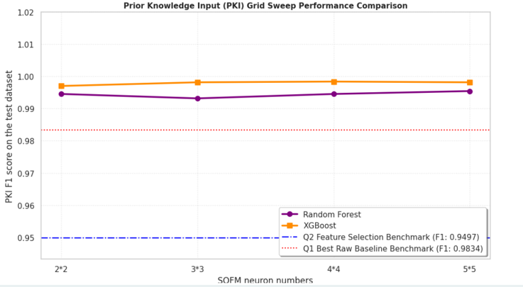
Results: Spatial Prior Knowledge Input (PKI) Optimization
Spatial PKI Performance (SOFM Injection)
CONCLUSION

Slide 15
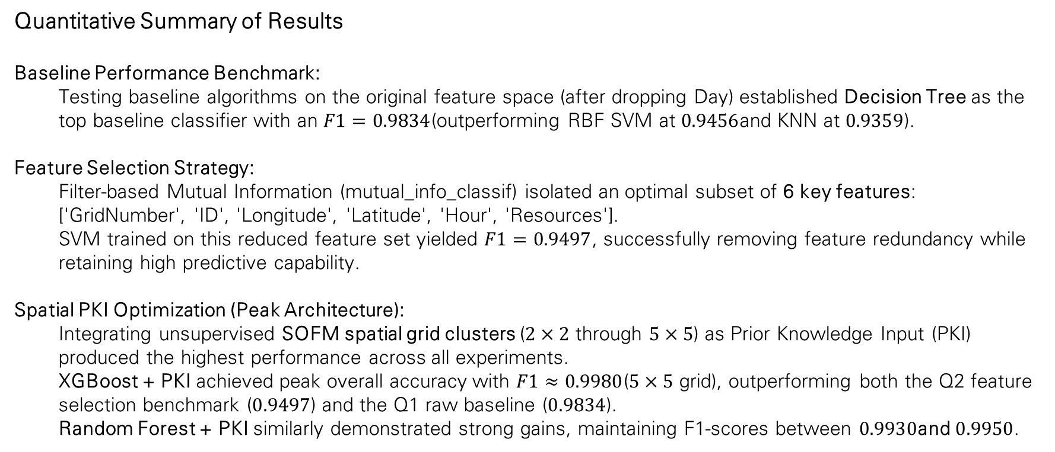
Comprehensive Performance Summary & Methodological Benchmarks
Quantitative Summary of Results
Baseline Performance Benchmark:
Testing baseline algorithms on the original feature space (after dropping Day) established Decision Tree as the top baseline classifier with an $F1=0.9834$(outperforming RBF SVM at $0.9456$and KNN at $0.9359$).
Feature Selection Strategy:
Filter-based Mutual Information (mutual_info_classif) isolated an optimal subset of 6 key features: ['GridNumber', 'ID', 'Longitude', 'Latitude', 'Hour', 'Resources'].
SVM trained on this reduced feature set yielded $F1=0.9497$, successfully removing feature redundancy while retaining high predictive capability.
Spatial PKI Optimization (Peak Architecture):
Integrating unsupervised SOFM spatial grid clusters ($2×2$ through $5×5$) as Prior Knowledge Input (PKI) produced the highest performance across all experiments.
XGBoost + PKI achieved peak overall accuracy with $F1≈0.9980$($5×5$ grid), outperforming both the Q2 feature selection benchmark ($0.9497$) and the Q1 raw baseline ($0.9834$).
Random Forest + PKI similarly demonstrated strong gains, maintaining F1-scores between $0.9930$and $0.9950$.
CONCLUSION

Slide 16
Observations
Comments:
Validation of Temporal Split: t-SNE projections confirmed strong structural alignment between Days 0–4 (Train) and Days 5–6 (Test), proving that dropping the Day feature eliminated temporal drift without compromising spatial topology.
Mitigating Class Imbalance: Optimizing specifically for F1-score effectively countered metric distortion caused by the ~87.5% to ~12.5% class imbalance between legitimate and fake tasks.
Efficacy of Spatial PKI Architecture: Pre-clustering continuous coordinates into discrete topological grid regions via SOFM provided downstream classifiers with explicit macro-regional context, demonstrating that the PKI framework improved predictive performance for task legitimacy detection within the CrowdSenSim dataset.
Generative AI tools (Google Gemini) were used as a supplementary resource for code review, feature-selection concepts, and methodological discussion. Final implementation, experimentation, validation, and interpretation were performed within the project workflow.
CONCLUSION

Slide 17
Sources:
Fiandrino, C., Capponi, A., Cacciatore, G., Kliazovich, D., Sorger, U., Bouvry, P., Kantarci, B., Granelli, F., & Giordano, S. (2017). CrowdSenSim: A simulation platform for mobile crowdsensing in realistic urban environments. IEEE Access, 5, 3490–3503. https://doi.org/10.1109/access.2017.2671678
Simsek, M., Kantarci, B., & Boukerche, A. (2020). Knowledge-based machine learning boosting for adversarial task detection in mobile crowdsensing. 2020 IEEE Symposium on Computers and Communications (ISCC), 1–7. https://doi.org/10.1109/iscc50000.2020.9219661
Google. (2026). Gemini (Gemini 1.5 Pro) [Large language model]. https://gemini.google.com
SOURCES

Slide 18
Link to the Project:
https://colab.research.google.com/drive/1lNckarOF95q8HpMSmTYe8xxLoPYVd5Xa?usp=drive_link

